Slide 1
Tmdb Movies
Let’s see my project

Slide 2
WHAT IS THIS
PROJECT?

Slide 3
This project is about
That there is top 5000 movies and my goal is to make insights about the data of this account

Slide 4





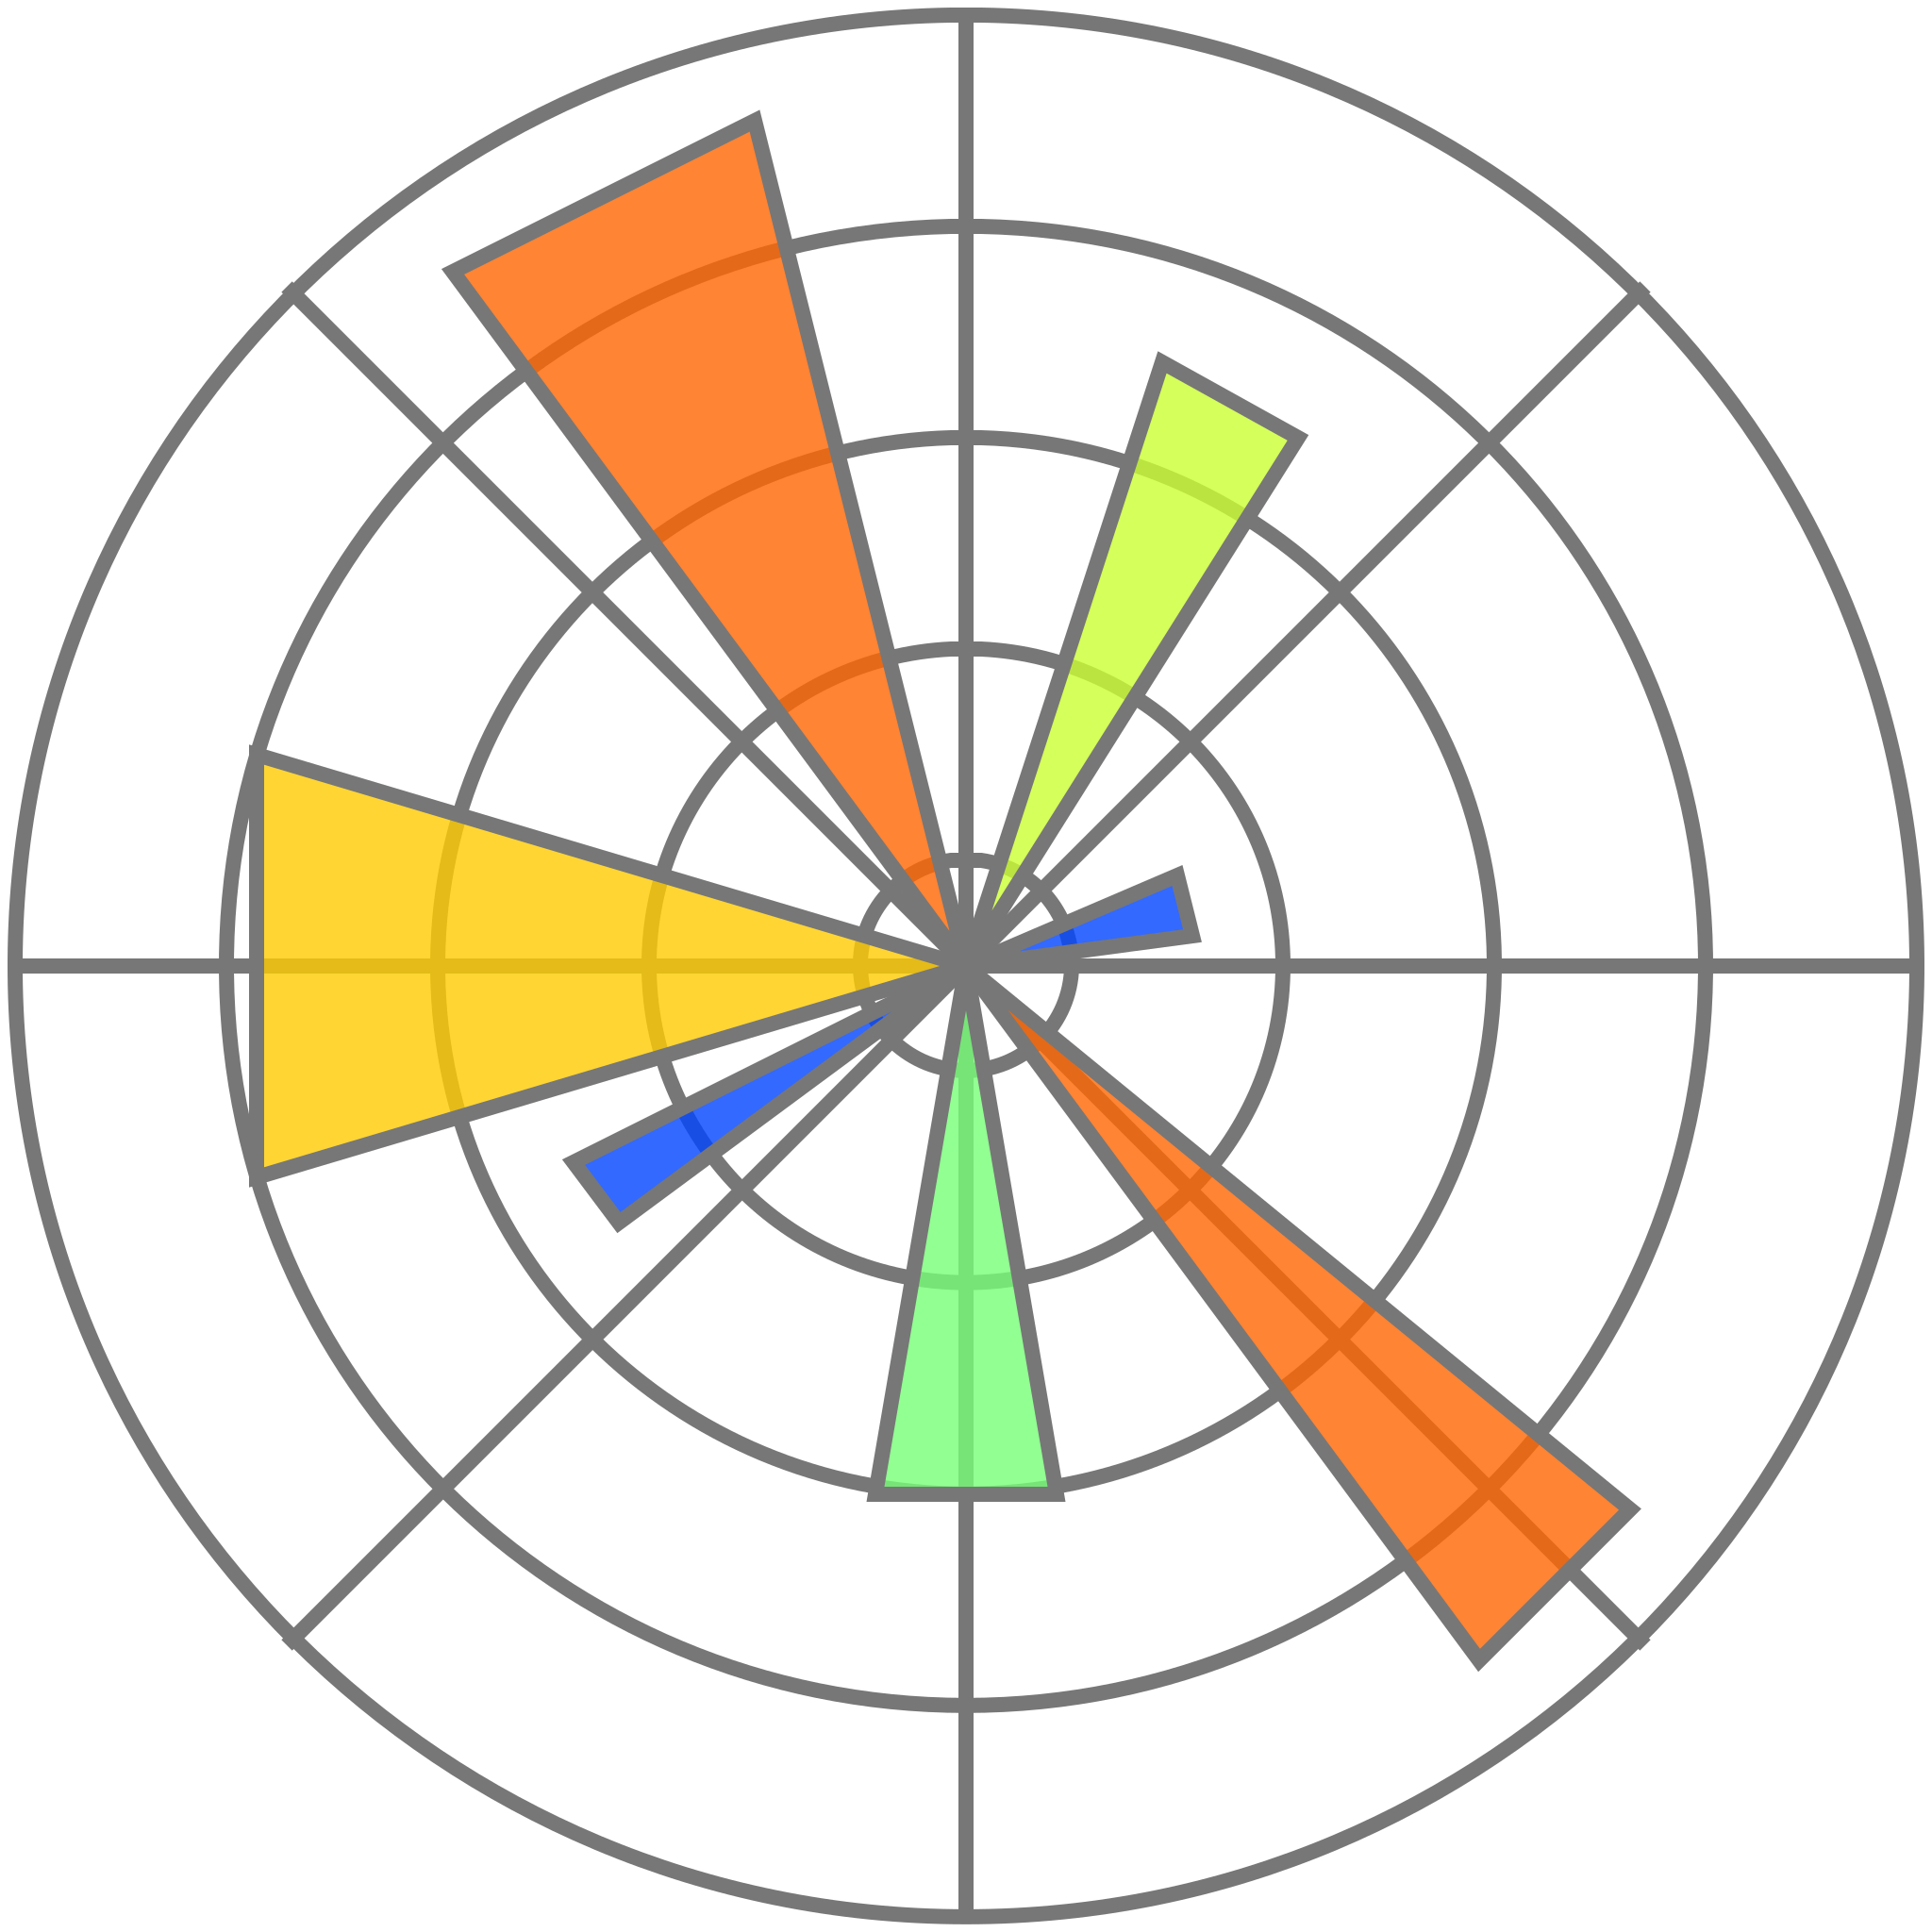
Tools I have used
1: Visual studio code
4: pandas library
2: Python language
2: Numpy library
3: jupyter notebook
3: Matplotlib library

Slide 5
Analysis steps
1
Gathering Data
3
Cleaning Data
2
Investigating Data
4
Visualizing Data

Slide 6
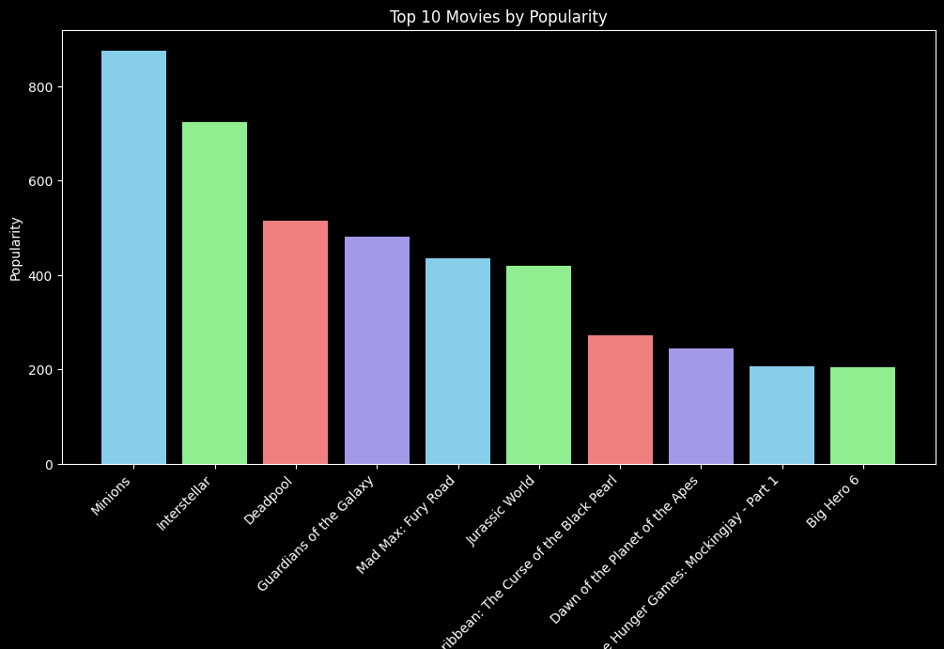
First insight:
THIS
The most Popular movie in this dataset is Minions

Slide 7
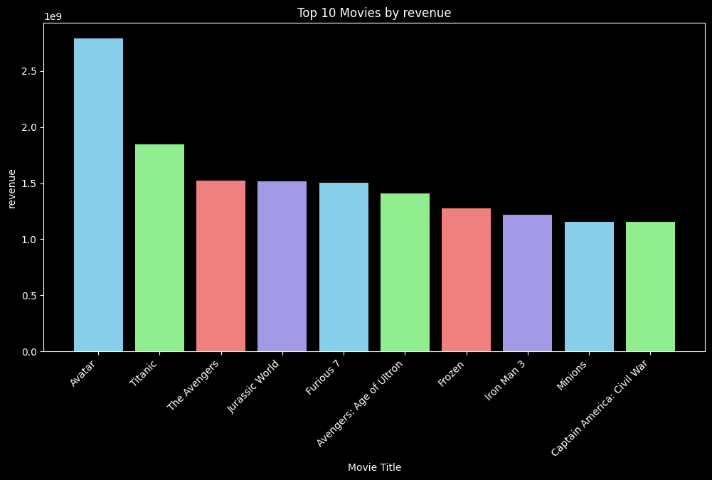
Second insight:
The most
Movie achieved revenue is Avatar
THIS

Slide 8
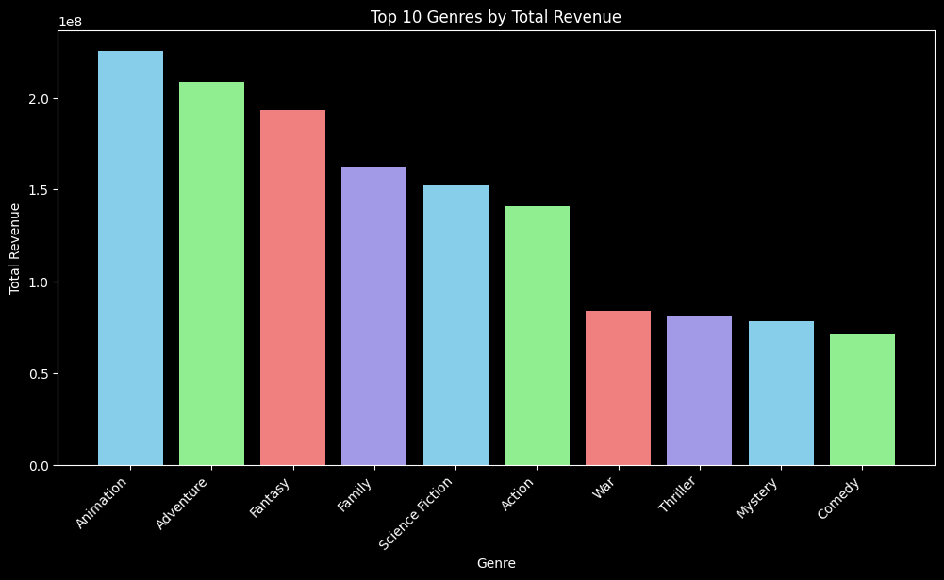
Third insight:
THIS
Top genre in revenue is Animation movies

Slide 9
conclusion:
1 English movies are top movies
2 Animation movies are top movies
So I suggest if you want to make a movie make it an animation movie in English

Slide 10
Thanks for your time
👋

